Slide 1
Automatic program repair
2020-12-10
JuHyoung Kim
kjhkjh75@naver.com

Slide 2
Identifying Patch Correctness in Test-Based Program Repair
Yingfei Xiong, Xinyuan Liu, Muhan Zeng, Lu Zhang, Gang Huang
ICSE2018

Slide 3
- Introduction
Multiple automatic program repair systems produce much more incorrect patches than correct patches
Test suites cannot guarantee the correctness of the patches
->Developers have to manually verify patches.
Weak test suite is not enough to filter out the incorrect patches produced by program repair system
-> Enhance the test suite
Generate new test cases
->Cannot oracle automatically generated
Goal is to classify patches heuristically without knowing the full oracle.

Slide 4
- Introduction
PATCH-SIM
- Passing test usually behaves similarly as before, while a failing test usually behaves differently
TEST-SIM
- Two tests have similar execution, they are likely to have the same test results
Steps
1) Generate a set of new test inputs.
2) Classify the newly generated test inputs as passing or failing tests by comparing them with existing test inputs.
3) Determine the correctness of the patch by comparing the executions before and after the patch for each test, including both tests.

Slide 5
- Introduction
Main contributions
1) Propose two heuristics, PATCH-SIM and TEST-SIM for indicators of patch correctness
2) Design a concrete approach that automatically classifies patches
3) Evaluated the approach on a large set of patches, showing usefullness

Slide 6
- Related Work
Test-based Program Repair
Patch Classification
Patch Ranking
Approaches to the oracle problem

Slide 7
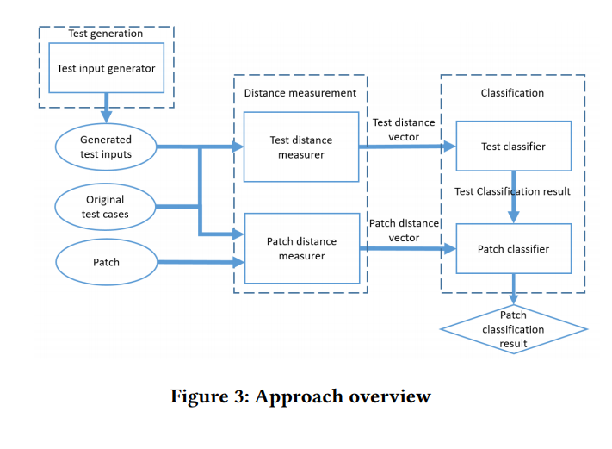
- Approach
Five components
Test generation
Test distance measurer
Patch distance measurer
Test classifier
Patch classifier

Slide 8
- Approach
1. Overview
Collect test execution runtime information, Calculate the test distance between generated test input and each original test case
Result is a vector of test distances, then passed to test classifier, which classifies the test as passing or failing
Patch distance measurer runs each test on the original program and the patched program and measure the distance between two execution.
This result is also vector and taken into patch classifier which determines patch correctness

Slide 9
Approach
2. Test Generation
Generated tests to cover the patched method.
Any test input generation techniques can be used
Utilize symbolic execution techniques to cover the specific method
Adopt random testing techniques, filter out don`t cover modified method

Slide 10
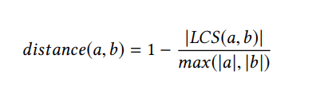
Approach
3. Distance Measurement
Measuring Distance
- complete-path spectra
Test Distance Measure
- Calculate generated test with each original test
- Executed statements with the calling context of the patched methods.
1) Entering a patched method from a method call
2) Leaving the method from the same call and keep only the statements between the positions.

Slide 11
- Approach
3. Distance Measurement
Patch Distance Measurer
- generated or original and calculates the distance between its executions on the original program and on the patched programs.
- Different from test measurer, consider the full sequence of executed statements.
- Because Same test, unlikely to be noises outside the patched method

Slide 12
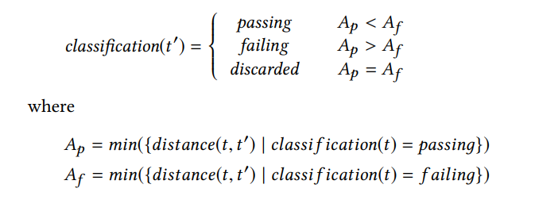

- Approach
4. Classification
Test classifier
- classifies the test result of a generated test as passing or failing.
- Difficult to precisely classify, discard these tests.
T = original test
T’ = generated test
In case of least a passing test
- No passing test case

Slide 13
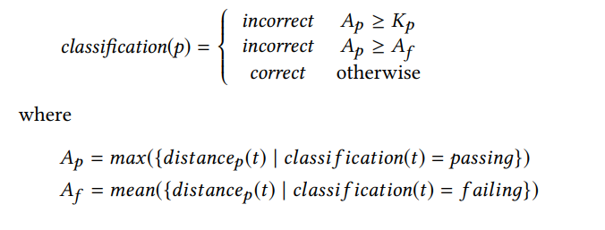
- Approach
Patch classifier
- : distance between the executions of test t before and after the patch p

Slide 14
- Implementation
-
Choose Randoop, a random testing tool, as the test generation tool.
Testing tool making fewer test, were not used , not enough for statistical analysis.

Slide 15
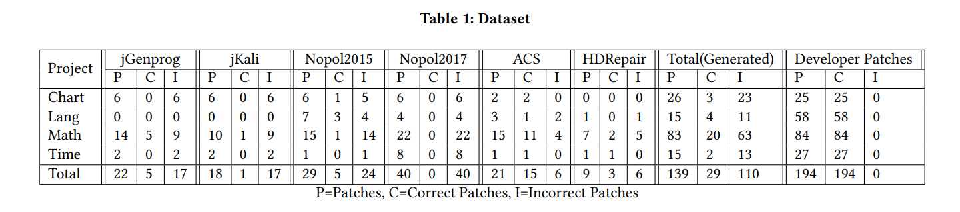
- EVALUATION
Dataset

Slide 16
- Evaluation
Experiment Setup
Test Generation
- Randoop to run 3minutes on the original program and collected the test sets that covered the patched methods.
- Most defects enough for 3minutes, lengthening the time would not lead to more test
- randomly selected 20 test, or selected all ( <20)
- 7.1 tests per patch in average, minimum 0
- Based on classification of Test-SIM, 71% tests passing

Slide 17
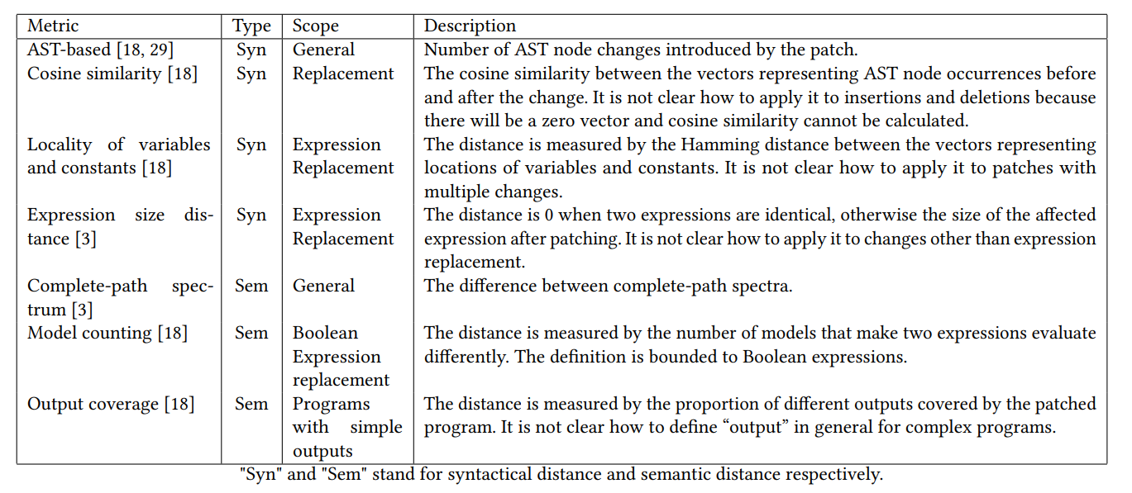
- Evaluation
Syntactic and semantic metrics

Slide 18
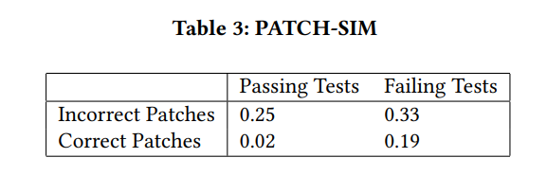
- Evaluation
Result of RQ1 : Reliability of Heuristics
Correct Patches are different Passing Test from Failing tests.
Incorrect Patches not

Slide 19
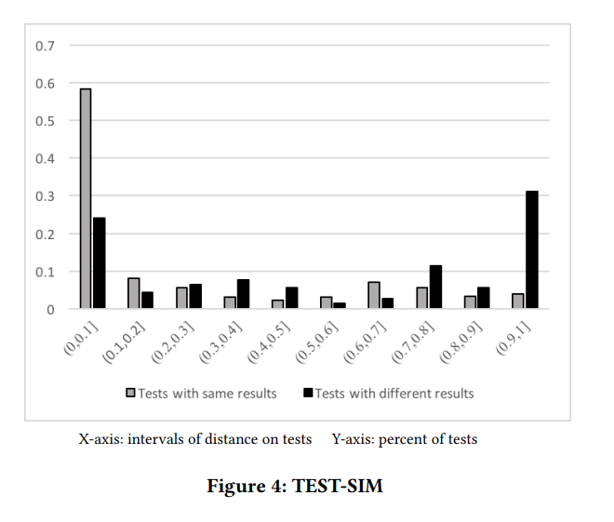
- Evaluation
Result of RQ1 : Reliability of Heuristics
Shorter distances, more likely to have the same test results.
On the other hands, opposite results.

Slide 20
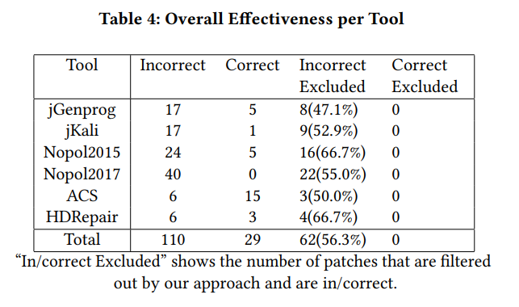
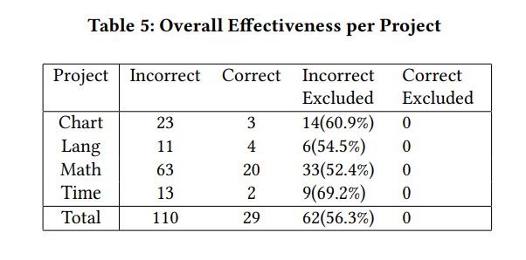
- Evaluation
Result of RQ2: Overall Effectiveness

Slide 21
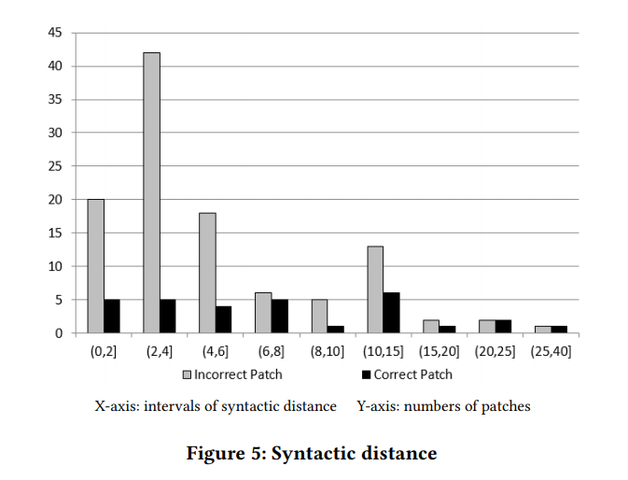
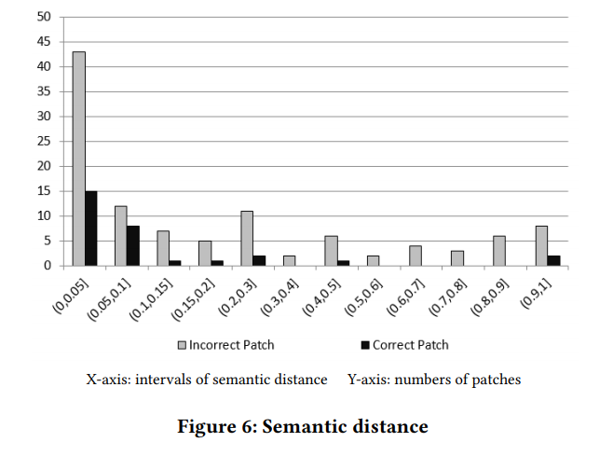
- Evaluation
Result of RQ3: Comparing with Others
Anti-patterns : filtered out 28/139 patches. 27 incorrect 1 correct
Opad : failed to recognize incorrect patches on same set

Slide 22
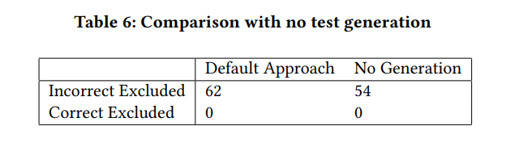
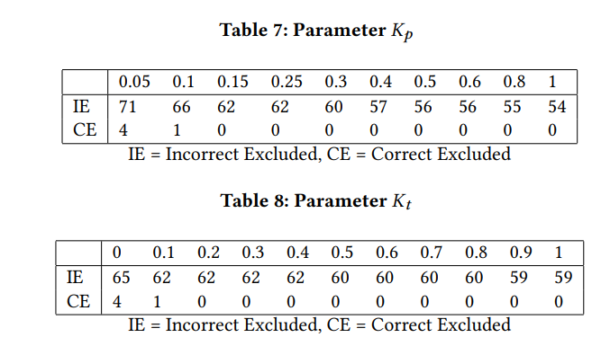
- Evaluation
Result of RQ4 : Effects of Test Generation.
Result of RQ5: Parameters
PATCH-SIM alone makes an effective.
Does not require a precise tuning of parameters.

Slide 23
- Evaluation
Result of RQ6: Causes of Wrong Result
1) Too weak test suite : 21 out of 48 that only one failing test covers the patched method. And no passing test, relies on the threshold K
2) Unsatisfying test generation : 27 out of 48 test generation tool fails to generate satisfying tests.
3) Unsatisfying classification formula : 8 out of 48 Using calculated the average distance of all failing test executions. Large value may impact

Slide 24
- Evaluation
Result of RQ7 : Developer Patches
194 correct developer patches, tool classified 16 patches is incorrect
1) human patches are more complex than automated techniques
2) when the complexity grows, tool
3) To enhance the performance, PATCH-SIM and CPS needed

Slide 25
- Threats to validity and limitations
Internal validity : discarded some patches for correctness cannot be determined
External validity : generalization for different types of program repair tools
Construct validity : correctness of the patches are manually evaluated

Slide 26
- Idea
The overfitting problem in automatic program repair
-> Current progress in mitigating the overfitting problem
1) Program repair tools that can prioritize the correct patch before the overfitting one
2) Validate patches generated by any program repair tool.
Second approach : Identifying Patch Correctness in Test-Based Program Repair

Slide 27
- Idea
Most Apr techniques own standard for Patch generation
- ex) Pattern based, Machine learning based, Search-based…
So, their patches have risk for overfitting.
Calculating similarity before and after patch is not enough.
So We need to compare failed patch with next generated patch even though all test cases pass to find correctness.
Among plausible patches , More similarity with failed patch, should have lower rank than others.
Bug file don`t tell the techniques trend, but failed patch can tell the trend of the techniques.

